Slide 1

UPI Fraud Ring & Merchant Analytics
FinTech & BFSI — Data‑Driven Fraud Intelligence
Datathon project • Team project
Technologies: Python • Pandas • Plotly • Streamlit • NetworkX • Jupyter • GitHub

Slide 2
Problem Statement
Volume & Complexity
Multi-source Investigation
UPI systems produce high-velocity transaction data that hides multi-party patterns.
Effective triage requires fusing Transactions, KYC, Merchant Master, and Chargebacks.
Connected Risk
Objective
Simple transaction-level alerts miss velocity, repeated actors, identity anomalies, and connected clusters.
Deliver an explainable analytics framework to surface suspicious transactions and prioritize investigations.

Slide 3

Dataset & Data Architecture
Transactions → Merchants
UPI Transactions
20,000 rows
Merchant linkage
Transactions → Users/KYC
Post-cleaning Dataset Sizes
KYC Records
36,122 rows
Identity enrichment
Chargebacks
Merchant Master
2,800 rows
6,198 rows
Post-cleaning dataset sizes shown above. Key relationships enable enrichment and investigation-level evidence.

Slide 4
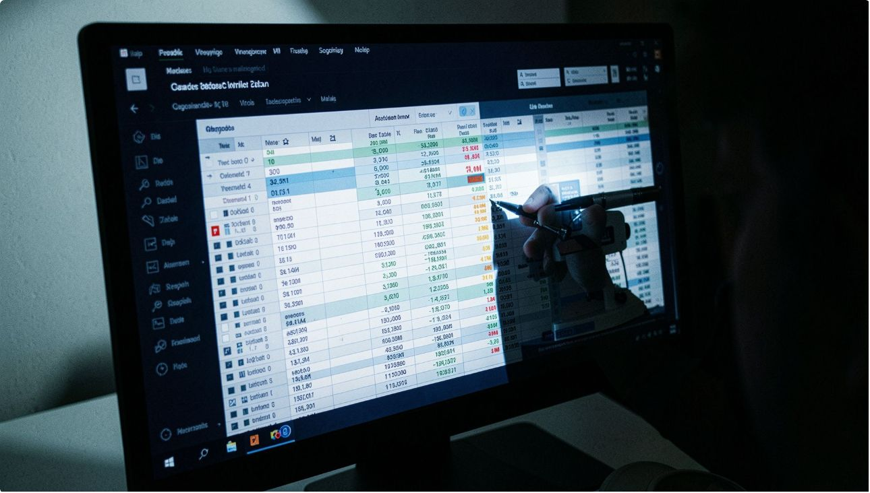

Data Quality & Cleaning
Key data issues
Exact duplicates, missing/negative amounts, missing UTRs
Mixed timestamp formats, inconsistent statuses
Duplicate/conflicting KYC identities; merchant master conflicts
Missing/invalid chargeback amounts; negative reporting delays
Cleaning pipeline
Normalize → Validate → Deduplicate
Standardize formats → Join sources
Preserve unmatched records with match flags
Create quality flags for downstream triage
Unmatched KYC/merchant records were preserved and flagged — NOT automatically labeled as fraud.

Slide 5

Integration & Feature Engineering
Feature Engineered Fact
Enriched KYC & Merchant
Raw Transactions
Final fact table: 20,000 transactions • 95 columns — enriched signals power explainable risk scoring and investigations.

Slide 6
Executive Transaction Insights
Total Transactions
Total Value
20,000
₹214,057,673
Average Value
Successful
₹11,893
17,053
Failed
Pending
1,955
992
Chargeback Txns
Fraud/Unauthorized Chargebacks
2,451
873

Slide 7
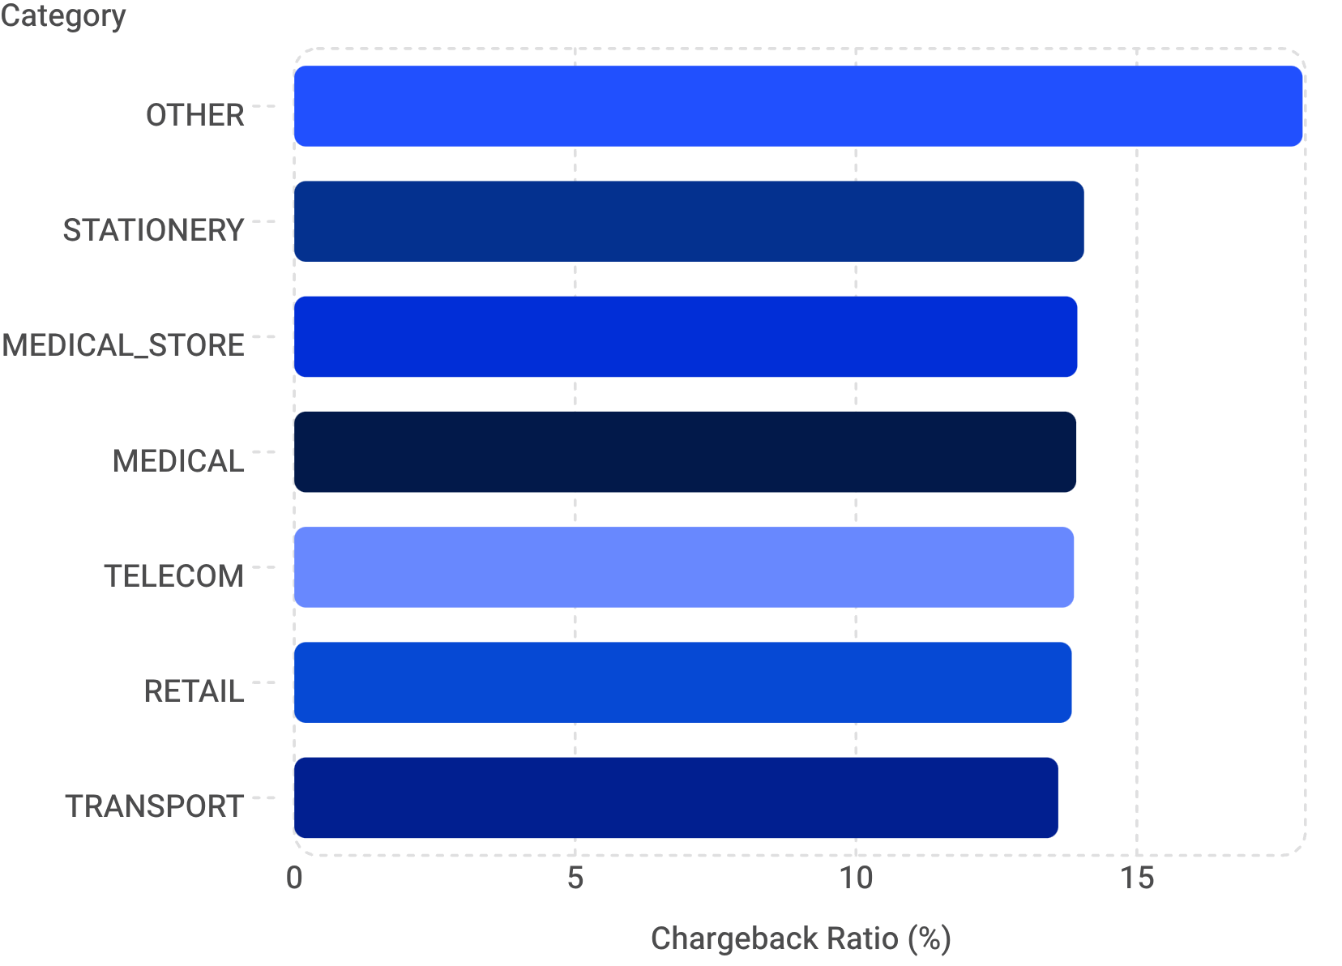

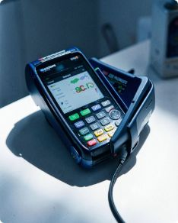

Merchant & Category Intelligence
Category chargeback ratios (examples)
Merchant Coverage
Priority Merchants
8,051 merchant IDs appear in the transaction fact table; 658 meet ≥5 txn threshold for meaningful ranking.
88 merchants meet priority: ≥5 transactions AND ≥2 chargebacks (example candidates to review).
A high chargeback ratio is a risk signal — not proof of merchant fraud.

Slide 8

Explainable Fraud‑Risk Scoring
1
2
Weighted signals
Risk bands
Fraud/Unauthorized Chargeback: 30
Chargeback: 15
Strong Identity Anomaly: 15
Repeated Chargeback User: 10
High Chargeback Merchant: 10
High‑Risk User: 5
KYC Rejected Transaction: 5
Velocity Anomaly: 5
High‑Value Transaction: 3
Risky Merchant Status: 2
LOW: 0–19 • MEDIUM: 20–39 • HIGH: 40–59 • CRITICAL: 60+
Score = explainable risk ranking for prioritization — NOT a calibrated fraud probability.

Slide 9
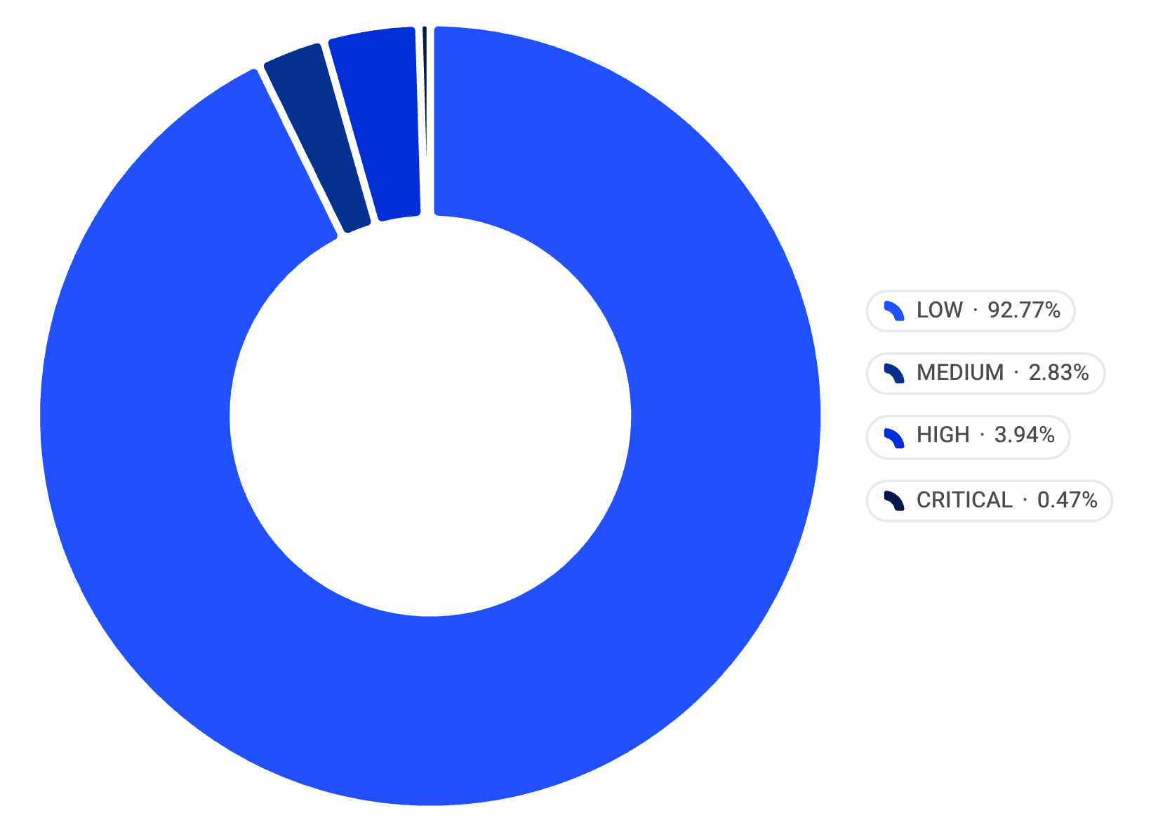
Risk Results & Triage
Fraud evidence
Investigation guidance
873 transactions with fraud/unauthorized chargeback evidence (used as a high-weight signal).
High/critical items are investigation candidates — not automatically labeled fraudulent.
HIGH + CRITICAL = 882 transactions flagged for investigation.

Slide 10
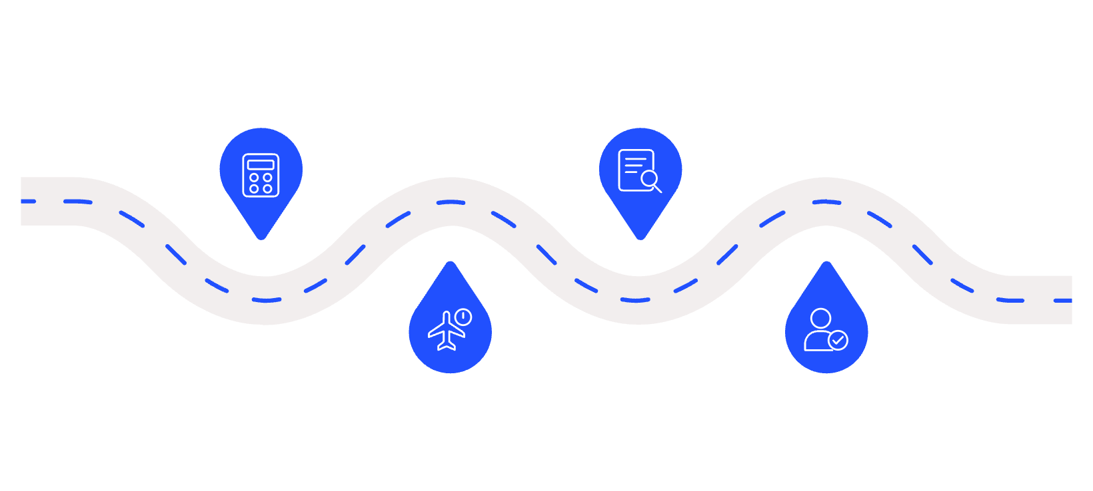
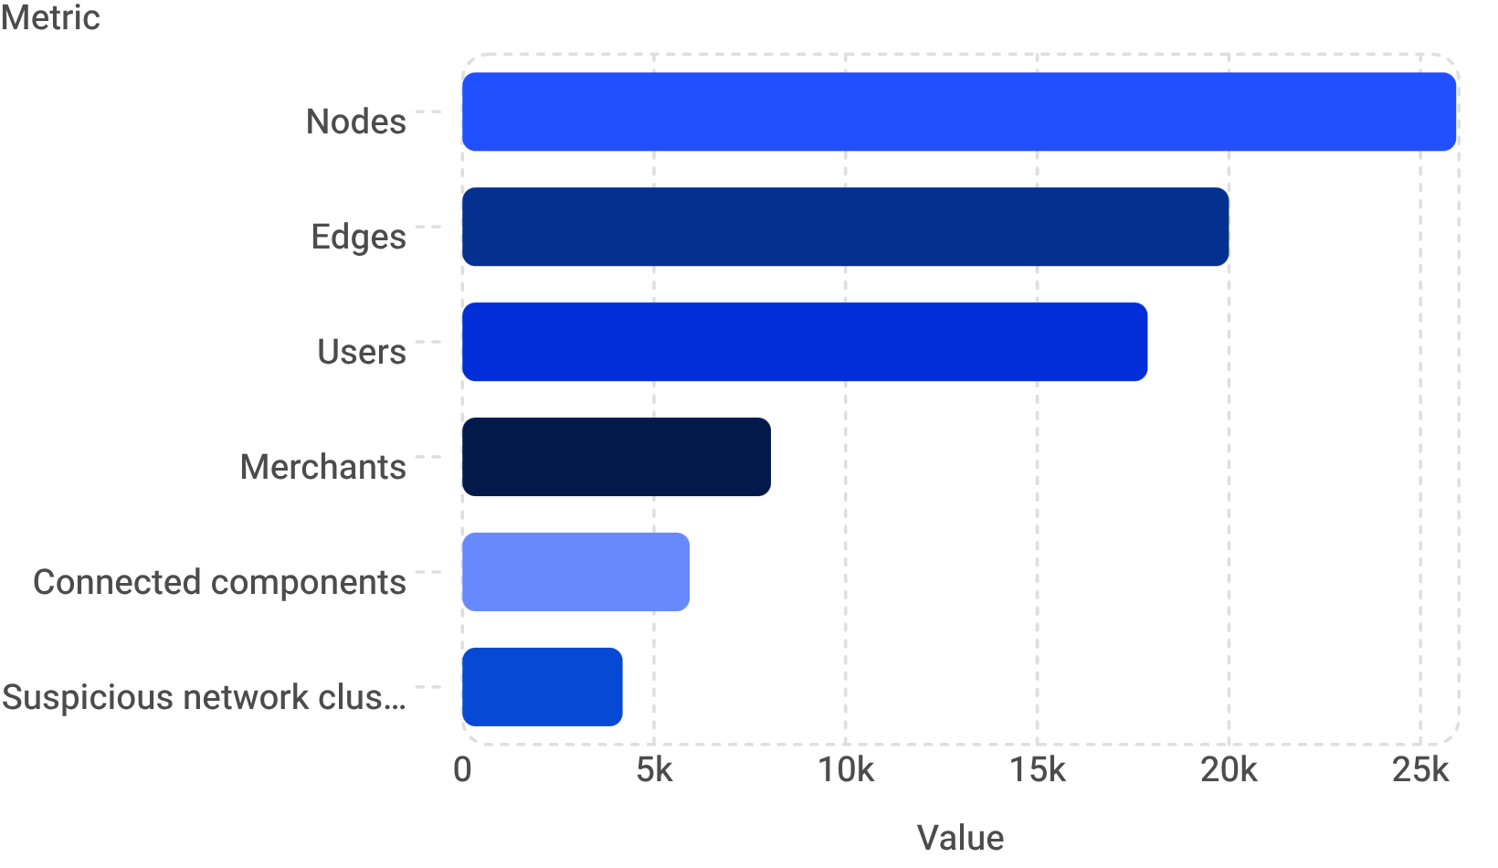
Investigation Workflow & Network Overview
Network overview
Investigation pipeline
Users ↔ Merchants transactions; clusters are signals for deeper review, not proof of rings.
Risk Scoring
Evidence
Compute threat score per case
Extract transaction and network data
High/Critical
Investigator Review
Select top-risk items for P1/P2
Analyst validates and assigns action
Priority split
P1 Immediate Review: 94 • P2 High: 779 • P3 Review: 9

